Slide 1
Part I Syllabus – Fundamental Underlying Layers
Week​ | Date​ | Subject​
Week 1 | 9/Jan/2023​ | Introduction: Course Logistics and Internet History​
 | 11/Jan/2023​ | Layered Network Architecture​
Week 2 | 16/Jan/2023​ | Physical-layer Resilience
 | 18/Jan/2023​ | Data Link Layer: Flow Control​
Week 3 | 25/Jan/2023​ (no class on 23/Jan/2023, a holiday​) | Data Link Layer: Error Control​
Week 4 | 30/Jan/2023​ | Local Area Network: Introduction​
 | 01/Feb/2023​ | Local Area Network: Medium Access Control (MAC)​
Week 5 | 06/Feb/2023​ | Local Area Network: Ethernet​
 | 08/Feb/2023​ | Local Area Network: Ethernet Evolutions​
Week 6 | 13/Feb/2023​ | Wireless Local Area Network (WLAN): Overview and 802.11
 | 15/Feb/2023​ | First Part: WLAN’s Multi-Access Reservation Protocol (MARP); Second Part: A Brief Overview of Network Paradigms​
Week 7 | 20/Feb/2023 | Network Paradigms​: Circuit Switching versus Packet Switching
 | 22/Feb/2023 | Mobile Access Networks

Slide 2
Additional Materials
The related content talked today in https://eclass.teicrete.gr/modules/document/file.php/TP326/%CE%98%CE%B5%CF%89%CF%81%CE%AF%CE%B1%20(Lectures)/Computer_Networking_A_Top-Down_Approach.pdf is as follow:
Physical Media: Page 18 – Page 22
MAC Protocols: Page 445 – Page 449
ALOHA Protocols: Page 450 – Page 453
CSMA and CSMA/CD Protocols: Page 453- Page 459
You can also find other video materials about
Physical Layer https://www.youtube.com/watch?v=rKzDbdGhcdY
CSMA https://www.youtube.com/watch?v=MAZi6VoekYw
Controlled Access Protocol-Reservation https://www.youtube.com/watch?v=baaPXiQ44vs
Notes:
This lecture starts with the basic functions of the data link layer, and the first one is flow control. Then next week we will talk about error control. Those are two fundamental functionalities of data link layer. We'll explain the reason why we need these functions and explain actually how they work. As a matter of fact, these two components are not just for the data link layer. So later on you'll study in the second part about TCP in the transport layer and use a very similar mechanism to guarantee reliability. Therefore, some students at end of the class or the course get very confused about why we have similar things happens here and there. But in fact that's also another engineering aspect of computer science is that the same building block can be used by different function blocks. Since they worked well and works in similar ways with similar requirement, before they get reused in many different components, especially for this, for example flow control and area controls. The same type of protocol are going to be used in both data link layer and transport layer.

Slide 3

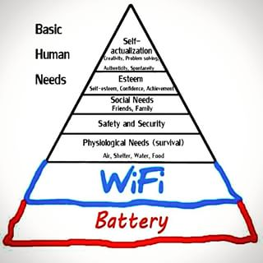
What is the problem with the guy?
Notes:
This is just a funny photo. This guy is the only one not on his phone. Another joke is that basic human needs include battery and wifi.

Slide 4

SC2008/CZ3006/CE3005 ​ Computer Network
Lecture 8
Wireless LAN: IEEE 802.11
Notes:
The wireless network protocol is mostly defined by this set of protocols; the IEEE 802.11,

Slide 5
Contents
WLAN Overview
WLAN Standard
WLAN Architecture
WLAN Protocol Stack
802.11 Physical Layer
802.11 MAC Layer
Hidden and Exposed Terminal Problems
CSMA/CA Protocol
MAC Management
Multi-Access Reservation Protocol
Scheme
Utilization Calculation
Notes:
and this is the structure of this part. We will overview the wireless network first, then we will look at the physical layer and the MAC layer of the wireless network, and then we will discuss multiple access reservation protocol.

Slide 6
WLAN Overview
Notes:
The overview

Slide 7
LAN/WLAN World
LANs provide connectivity for interconnecting computing resources at local levels of an organization
Wired LANs
Limitations because of physical, hard-wired infrastructure
Wireless LANs
Flexibility
Portability
Mobility
Ease of Installation
Notes:
So in the last part we have learned the ethernet and in ethernet we have to lay down the cables ... we need to do the cabling work and that is tedious, so it will be better if we can do the communication wirelessly, then we will have more flexibility, portability, mobility, and also it is easy to install.

Slide 8
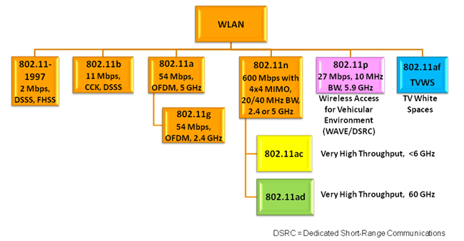
IEEE 802.11 WLAN Standard
not examinable
In response to lacking standards, IEEE developed the first internationally recognized wireless LAN standard – IEEE 802.11
IEEE published 802.11 in 1997, after seven years of work
Most prominent specification for WLANs
Scope of IEEE 802.11 is limited to Physical and Data Link Layers
Notes:
In this wireless part we have a family of protocols and you can see; initially the first wireless protocol was defined in 1997, and later we have evolving versions and each version has a suffix to represent. We have this Version B, Version A, Version D, Version N and et cetera. Different versions have slightly different specifications and also give you different performance and data rates.

Slide 9
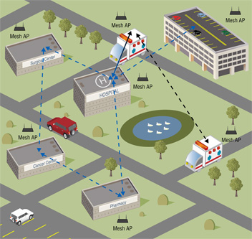

Wireless LANs: Characteristics
not examinable
Advantages
Flexible deployment
Minimal wiring difficulties
More robust against disasters (earthquake, etc)
Historic buildings, conferences, trade shows,…
Disadvantages
Low bandwidth (1-10 Mbit/s) compared to wired networks
Proprietary solutions
Need to follow wireless spectrum regulations
Notes:
Now, the advantage of a wireless network is more flexible to deploy, and we don't have to lay down the cabling and especially during some disaster events, it is easier to deploy. But we do have disadvantages, which is the bandwidth is lower than the wired network. This is some years ago, the maximum bandwidth that we can have is just up to 10 mega BPS. Remember in the last part, the highest bandwidth we can have on the wired network is up to 10 giga BPS. Much, much higher than this one, and the wireless solutions are proprietary. those manufacturers hold some patterns, and if you want to design your own wireless module, you have to pay some patent fee. This involves the cost, and the transmission has to follow the regulations on the wireless spectrum because those wireless technologies share the same communication media.

Slide 10
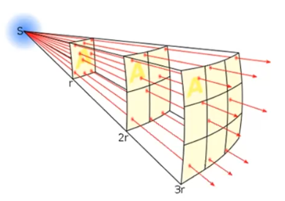
Wireless Link Characteristics
not examinable
Different from wired link …
Decreased signal strength: radio signal attenuates as it propagates through matter (path loss)
Interference from other sources: standardized wireless network frequencies (e.g., 2.4 GHz) shared by other devices (e.g., phone); devices interfere as well
Multipath propagation: radio signal reflects off objects ground, arriving at destination at slightly different times
… make communication over wireless link much more “difficult”
Notes:
Now, those are the characteristics of a wireless link, and those are different from the wired link. First of all, we will have significant reduced signal strength. This is because when the wireless signal propagates over the free space, the same amount of energy of the signal has to cover larger and larger areas, when the distance from the transmitter increases, meaning that a certain amount of energy of the transmitted energy needs to be divided by a larger and larger area, but as the receiver, you can only receive the signal over a limited area. For example, at this distance; a shorter distance, if you fix the area of the antenna, then you can receive this much amount of energy, but if this receiver is operating at a longer distance from the transmitter, then if the area of the antenna is the same, then the total energy received by this antenna will be smaller, because the same amount of energy needs to cover a larger area, so
the signal attenuates with the distance. We also have interference from the other sources; this is because the wireless network is operating in the same frequency band with other technologies. For example, the Wi-Fi is using 2.4 gigahertz,, but different devices using wifi will compete for the communication media. Another issue is the multipath propagation, meaning that the wireless signal may propagate over different paths and some of the signals may be reflected by some surface. Then, what the receiver gets is actually the sum of multiple versions over different paths, and those different versions may arrive at the receiver at slightly different times, then you can see that this issue may cause some problems.

Slide 11
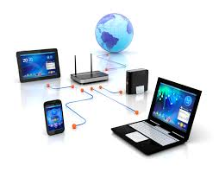
WLAN Architecture
not examinable
Building Modules
Station (STA)
Mobile node
Smartphone, pad, laptop
Access Point (AP)
Stations are connected to access points.
Two Architectural Modes
Infrastructure: centralized
Ad Hoc: distributed
AP
Infrastructure
Ad Hoc
Notes:
This is the architecture of the wireless LAN. We have those terms; the station (STA), meaning the mobile station, like your laptop, your smartphone, et cetera. Now we have the access point. Those stations will connect to the access point. Then we have two architectures; the first is the infrastructure mode, meaning that all the stations in the network are managed by the centralized AP. It means that we'll need an AP to provide the network connectivity to all the stations in this network. The second one is ad hoc, meaning that within a network, the stations can talk to each other. in our daily life, we mostly use this infrastructure mode. We need to set up an AP and then connect our devices to the AP to access the internet.

Slide 12

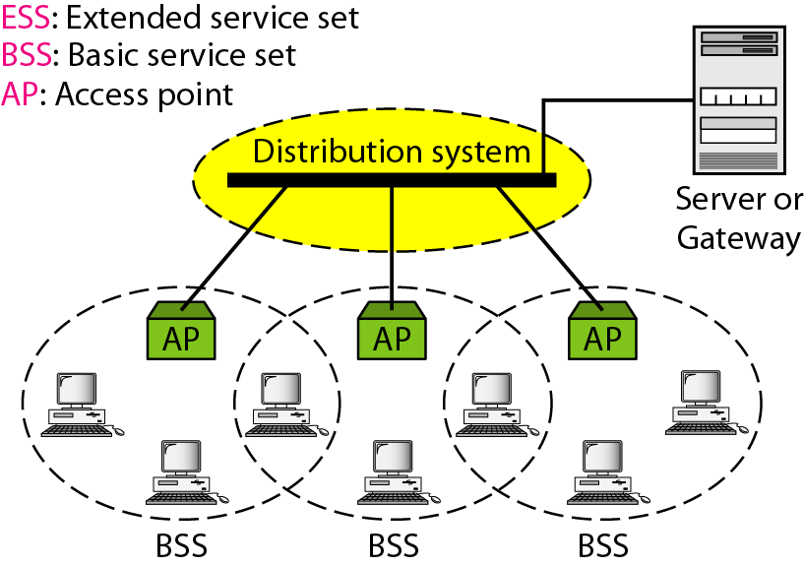
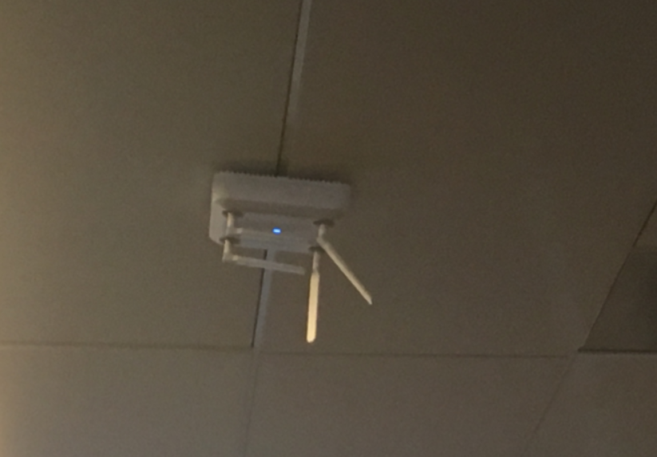
(Extended) Service Set
not examinable
Basic Service Set (BSS)
Stations and the AP within the same radio coverage form a BSS.
Extended Service Set (ESS)
Several BSSs connected through APs form an ESS.
Notes:
More terms; the basic service set is the set of the stations connected to the same AP. Then, we can also use a network to interconnect those different multiple APs, then the sum of those stations within this whole network is called the extended service set. Now give you an example; in NTU, we have to deploy many APs within NTU, because we know the communication range for each AP is limited, so we have to deploy many APs to cover the whole NTU campus; for example, this is one AP which you may see on campus. each AP forms a basic service set, and all those APs are interconnected to form our NTU's Wi-Fi network, and this NTU's whole Wi-Fi network is an extended service set.

Slide 13
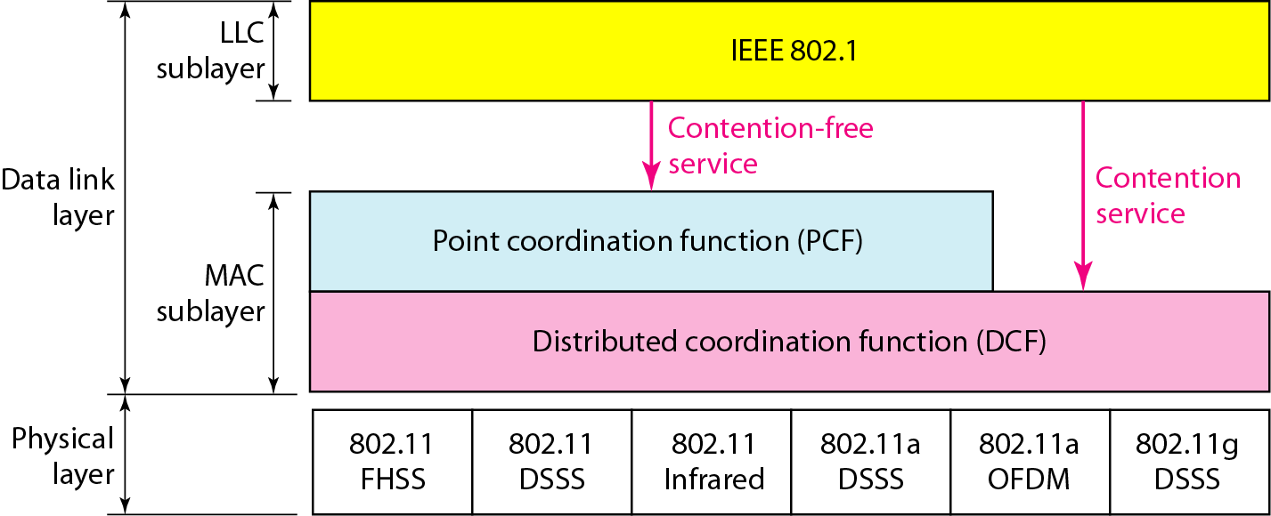
802.11 Protocol Stack
not examinable
Notes:
Okay, now this slide is the protocol stack of the wireless LAN, so basically we have different physical layer technologies and those terms are the signal modulation technologies, and we don't go into the details in this course. Then, on top of the physical layer, we have the data link layer, and we have two types of functions in this data layer. The first is the PCF; standing for point coordination function. The second is the distributed coordination function, DCF. The meaning of the point coordination function is that we use the centralized AP to coordinate the access of the multiple nodes within the same network. Okay, one example is this centralized AP will divide the time into time slots and allocate the time slots to the stations within this network, so this is PCF. The second is the distributed coordination function. If this Wi-Fi network is using the CSMA, meaning that we allow the stations within this Wi-Fi network to compete for the wireless channel, then this is a DCF, so we mean that we let the stations to coordinate by themselves in a distributed way, so that is DCF.

Slide 14
Wireless Physical Layer
not examinable
Notes:
Let's quickly go through the physical layer.

Slide 15
Radio Spectrum
not examinable
Radio Frequency bands are allocated to different applications
The use of most frequency bands needs licenses
IEEE 802.11 uses industrial, scientific and medical (ISM) bands that don’t require licenses if the radio transmissions follow the national/global regulations
Notes:
the wireless network needs to use the radio spectrum, and the Wi-Fi network is using the ISM bands, meaning industry, scientific, and medical bands. If you want to use this band then you do not have to obtain the license from some international organization, you just use it, as long as you meet some regulations, which is mostly about the transmission power. it means that if your transmission power is lower than some specified level, then you can use this frequency band for free.

Slide 16
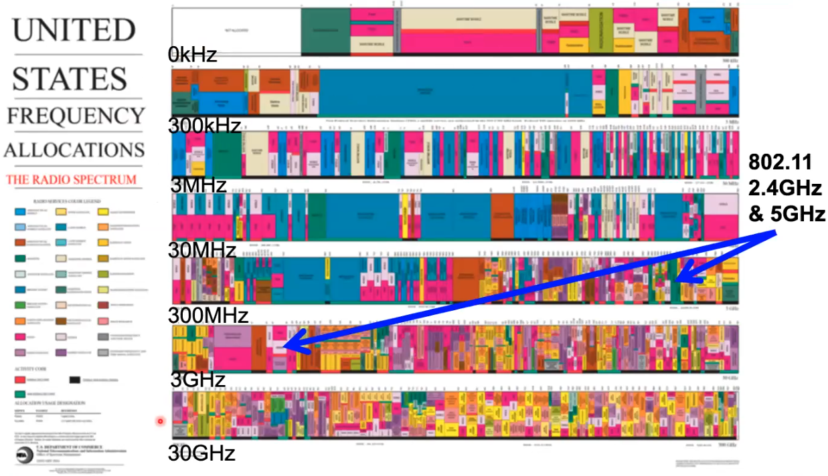
Sub-THz Radio Spectrum
not examinable
Notes:
here we have this illustration of the radio frequency. The X axis is the frequency, then we have to divide this frequency spectrum into multiple parts,, and this is where the Wi-Fi network's frequency spectrum, which is this part; this is 2.4 gigahertz and this is a 5 gigahertz used by the Wi-Fi network, and you do see that other frequency bands are used by other technologies. Most of those other technologies need to apply for a license from some international organization for them to use the channel legally, but for Wi-Fi we don't have, as long as your transmission power is lower than some level.

Slide 17
IEEE 802.11 Physical Layer
not examinable
 | 802.11b | 802.11g | 802.11a | 802.11n
Frequency Band | 2.4GHz | 5GHz | 2.4GHz | 2.4 | 5
Non-overlapping Channels | 3 | 3 | 12 | 3 | 12
Baseline BW Per Channel | 11Mbps | 54Mbps | 54Mbps | 65 | 65
Max BW Per Channel | 11Mbps | 54Mbps | 54Mbps | 130 | 270
MIMO | 1 | 1 | 1 | 4 | 4
Modulation | DSSS | DSSS/OFDM | OFDM | OFDM
Notes:
Here are some more specifications of the Wi-Fi. This is the frequency we use. This is the number of channels we have, and this is the bandwidth we can achieve under different subversions of Wi-Fi, and MIMO it means that whether the AP can support some concurrent transmission by using different subchannels. This is a physical layer modulation scheme.

Slide 18
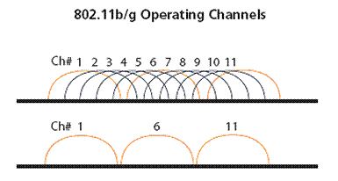
IEEE 802.11 Channels, Association
not examinable
802.11b: 2.4GHz-2.485GHz spectrum divided into 11 channels at different frequencies
AP admin chooses frequency for AP
Interference possible: channel can be same as that chosen by neighboring AP!
Notes:
Some more concepts about the channel. This axis is the frequency band, and then we will divide this frequency band into sub channels. For example, this is a frequency range for channel number one. This is for channel number two, up to the channel number 11, and for this wifi version 11b, we define 11 channels. Now an AP can choose one channel to operate, and if a station wants to use this AP, then that station needs to use the same channel as the AP, and among those 11 channels, we only have three channels that do not have overlap, which means that for example, within my office, if I set up two APs and one AP is operating at channel one, and the other AP is operating at channel six, now if I have two stations connecting to those two APs respectively, they can communicate at the same time without interfering with each other. But differently if one AP is using channel one, and the other AP is using channel two, then the communications with those two APs, if it will happen at the same time, will interfere with each other because those two channels have overlaps in the frequency band.

Slide 19
IEEE 802.11 Channels, Association
not examinable
802.11b: 2.4GHz-2.485GHz spectrum divided into 11 channels at different frequencies
AP admin chooses frequency for AP
Interference possible: channel can be same as that chosen by neighboring AP!
Host: must associate with an AP
Scans channels, listening for beacon frames containing AP’s name (SSID) and MAC address
Selects AP to associate with
May perform authentication (security purpose)
Will run DHCP to get IP address in AP’s subnet
Notes:
For hosts to access the network, it has to associate with some AP and we will use this process to illustrate how the client connects to the AP.

Slide 20
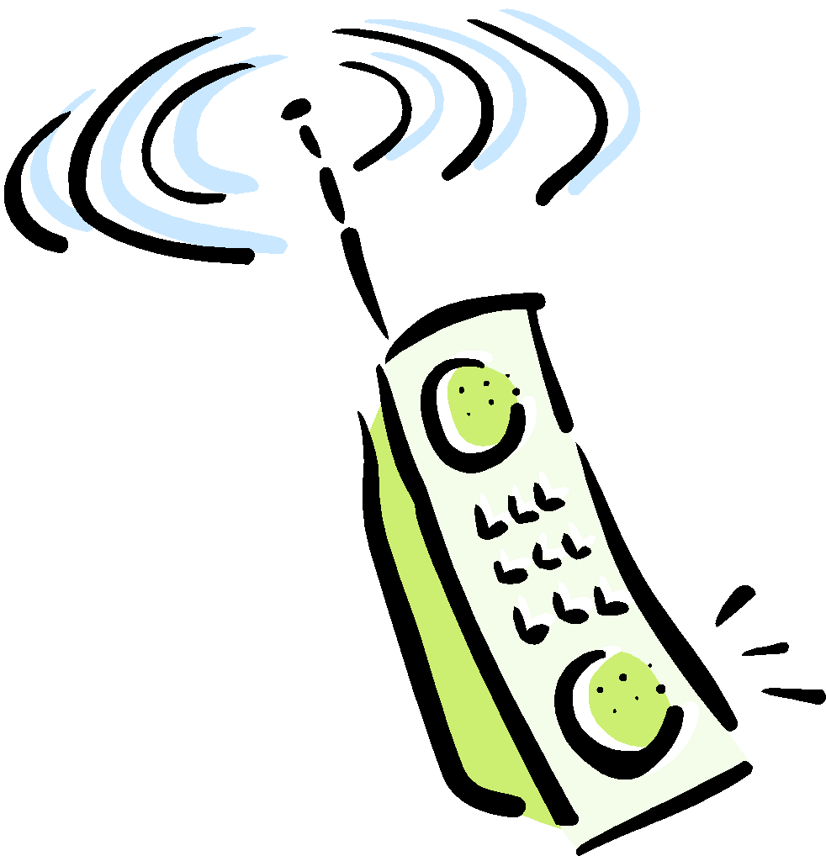

802.11 Passive/Active Scanning
not examinable
BSS 1
BSS 2
BSS 1
BSS 2
AP 1
AP 2
AP 1
1
AP 2
1
1
2
2
2
3
3
4
H1
H1
Passive Scanning:
beacon frames sent from APs
association Request frame sent: H1 to selected AP
association Response frame sent: Selected AP to H1
Active Scanning:
Probe Request frame broadcast from H1
Probes response frame sent from APs
Association Request frame sent: H1 to selected AP
Association Response frame sent: selected AP to H1
Notes:
We have two modes; the first mode is the passive scanning, so initially the APs will periodically broadcast beacons containing their names, so the name is the basic service set name and so those APs will periodically broadcast the beacons and now this host can receive the beacons and make a decision of which AP to choose. For example, this host can choose the AP providing stronger signal strength. Now let's say if this host chooses this AP2, then this host will transmit a frame to the AP2 to request setup authorization, then this AP2 will reply to a message to confirm. The second mode is those APs do not periodically transmit the beacons. Instead, if a station wants to connect to the Wi-Fi network, it will first broadcast a request message. Once these APs receives this broadcast message, these APs will reply a message to indicate its existence, then this host can choose one of them and send the request to set up the association, and also the AP needs to confirm using the fourth message, so this is the association process.

Slide 21
802.11 MAC
not examinable
Notes:
Now we will move on to the MAC protocol used by the Wi-Fi network.

Slide 22
802.11 MAC Sublayer
not examinable
New challenges caused by the nature of wireless communications
Broadcast
Signal attenuation
Pervasive electromagnetic noise
Three functional areas
Access control (random access vs controlled access)
Reliable data delivery (against noises and collisions)
Security (authentication, packet injection, …)
Two additional problems:
Hidden Terminal Problem
Exposed Terminal Problem
Notes:
in Wi-Fi networks, we do have those challenges; one is all the communication happens in the way of a broadcast. This is very similar to the bus topology of the ethernet, so all the stations share the same bus. If they transmit the signal, it's broadcasted into this bus, and this broadcast nature is different from the switch network, because in the switch network we will use the switch to do the switching, and only transmit the data to the necessary port. We don't have a switched mode for wireless networks. It is always broadcast.
Also, the wireless signal will attenuate over a distance, and we have the electromagnetic noises. I'm not sure whether you have tried to turn on your microwave oven and at the same time use your mobile phone to download data. You can do a speed test over the wifi network; you will see that when the microwave oven is operating, network speed of your smartphone is reduced quite a lot. You can do this experiment at your home. There are three functions that we need to pay attention to, which is the access control, meaning that how should we coordinate the stations' access to the shared wireless media, and how do we deal with noises and the possible collisions to achieve reliability, and also security. We do not cover security problems in this course, but wireless security is indeed a problem, because all the communication happens in the broadcast way. If there is a bad guy, he can easily set up a wireless sniffer to eavesdrop all the data communications. And we have two additional problems that are unique to wireless networks; which are the hidden terminal and the exposed terminal problem, and we will explain those two problems later.

Slide 23
Access Control
not examinable
Distributed Coordination Function (DCF)
Distributed access protocol
Contention-based
Makes use of CSMA/CA
Suited for ad-hoc network and asynchronous traffic
Point Coordination Function (PCF)
Alternative access method on top of DCF
Centralized access protocol
Contention-free, and works like polling
Suited for time-bound services like voice and multimedia
Notes:
I have explained the principles behind DCF and the PCF. DCF is to let the stations within the same network to compete for the resources, so they coordinate in a distributed way. PCF is to use the access point to coordinate the access of the network by the stations, so it is a centralized coordination.

Slide 24
Reliable Data Delivery
not examinable
Loss of frames due to noise, interference and propagation effects
Frame exchange protocol
Sender broadcasts data
Receiver responds with acknowledgement (ACK)
If sender does not receive ACK, it retransmits frame
Four frame exchange for enhanced reliability
Sender issues request-to-send (RTS)
Receiver responds with clear-to-send (CTS)
Sender transmits data
Receiver responds with ACK
Notes:
To achieve reliable data delivery, we have this mechanism, because we can have a loss of frames due to noise, interference, and the decay of the signal over a distance. This is the basic process to transmit data; the sender will first broadcast the signal, and if the receiver successfully received the data, then it will respond with ACK. If the sender does not receive the ACK, then the sender will retransmit the frame, but to enhance the reliability of the transmission, we will adopt the RTS and the CTS mechanism, so the sender will first issue the RTS to reserve the channel, then the receiver will respond with the CTS signal, to notify the sender, "Now you are okay to transmit." If the sender does not receive this CTS, then the sender should not transmit. After receiving this CTS, the sender can transmit and then we will do the ACK, so the additional thing here is we add the RTS and CTS, and this part is the normal mechanism for the wired network, and for wireless network, we additionally add the RTS and CTS. Now I will explain why we need the RTS and CTS.

Slide 25
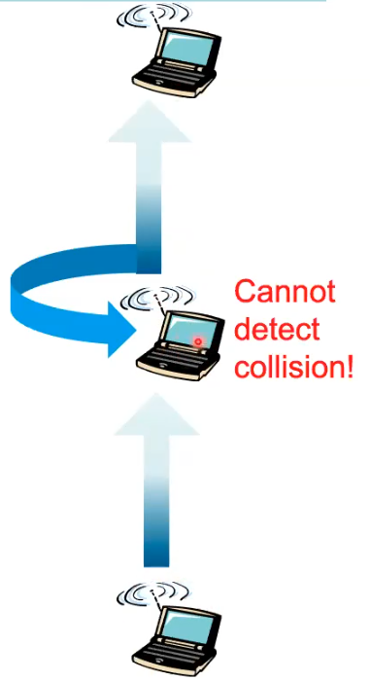
802.11 Multi-Access
not examinable
Collision
A receiver hears transmissions from 2⁺ nodes at the same time
802.11: CSMA - sense before transmitting
Don’t collide with ongoing transmission by other node
802.11: no collision detection!
Difficult to receive (sense collisions) when transmitting due to weak received signals (fading)
Can’t sense all carriers & collisions in any case: hidden terminal problem
802.11: avoid collisions
CSMA/C(ollision)A(voidance)
C
B
A
Notes:
???A, B, C
In wireless networks, it is very difficult to detect the collision, so we use this example to illustrate. in this example, this station A wants to transmit data to this station B, and then this station B wants to transmit to this station C, and now let's say if this station B started a transmission earlier, so the transmission is already ongoing, but due to the long distance between this station B and this station A, this station A cannot detect the ongoing transmission from this station B. Now, this station A will decide to transmit according to the CSMA principle. Now, this station A will transmit, but the trouble is; this station B is transmitting, so this transmitted signal by this station B will be also received by its own transceiver, and that signal is very, very strong, and that transmission will prevent this station B to receive the data from this station A and this is a collision. The trouble is; this station A has no way to detect this collision at this position, because it is different from the wired network. In the wired network, we know that the signal can propagate to this station A, so this station A can know the collision, but in the wireless signal, the signal decays with distance, so this station A may not detect the collision. From this example, you can see that due to the signal decay, it will be difficult to detect the collision. Here I'm not saying that we have no chance to detect the collision, I'm just saying; for some cases you cannot detect the collision. So based on this observation, the network designers take one step back, so we will avoid the collision. We do not try to detect the collision, we will avoid it by doing the CTS and RTS.

Slide 26
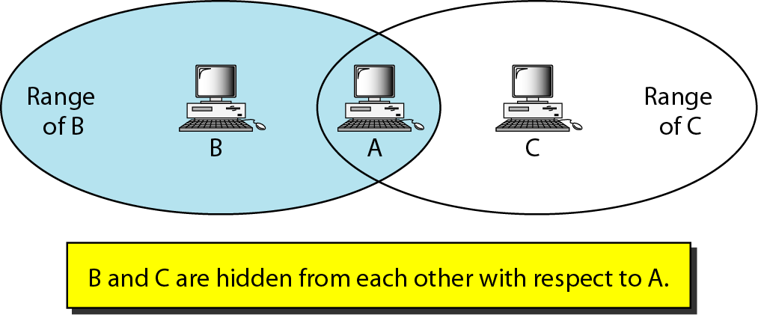
Hidden Terminal Problem
not examinable
Notes:
we will try to formalize the issue we discussed here using the hidden terminal problem. In this problem, we consider three stations; A, B and C. B and C are hidden from each other meaning that C cannot detect the transmission from B and B also cannot detect the transmission from C. Now, if B and C want to transmit data to A, and if they start the transmission at the same time, now the transmission will collide at A. In this case, remember that the CSMA is no longer valid because C cannot detect the transmission by B, and B also cannot detect the transmission by C, so they will collide at A, and the CD; collision detection is also invalid at this point, because there is no means for C to detect the collision at A. There is also no means for B to detect the collision at A, so this is called the hidden terminal problem.

Slide 27
Hidden Terminals in Wireless LAN
not examinable
C
A
B
C
B
C’s signal
strength
A
A’s signal
strength
Case 1: Caused by barrier
B, A hear each other
B, C hear each other
A, C can not hear each other
A, C unaware of their interference at B
A is a hidden terminal to C, vice versa
space
Case 2: Caused by signal attenuation
B, A hear each other
B, C hear each other
A, C can not hear each other
A, C unaware of their interference at B
Question: Does Ethernet have hidden terminal problem?
Answer: No. Ethernet does not have Case 1 and Case 2 above.
Engagement and critical thinking!
Notes:
We have two main reasons for the hidden terminal problem; one is the A and C are blocked by some barrier, so even if the direct physical distance from A to C is short, but because of the blockage, the A cannot detect the transmission from C, and C cannot detect the transmission from A. Then this forms a hidden terminal problem, and A and C are called the hidden terminals. The second case is a more general case; even without a barrier, but because of the attenuation of the signal over distance, eventually we have A and C to be the hidden terminals. this red curve represent the A's signal over the distance, and at the position of the C, the signal is very, very low, then C cannot detect A's signal, and the same to C, which is this blue curve. Then the A and C form a pair of hidden terminals with respect to B, and this happens everyday in our daily life. When you have many Wi-Fi terminals in a space, you most likely will have hidden terminals. Now the question here is; does the wired network have a hidden terminal problem? Yes or no? Maybe you can try to provide quick answers. no. In ethernet, no, because Ethernet does not have Case 1 and Case 2 above. we do not have the barrier case, and also the signal attenuation is not that significant in cables of Ethernet, so we don't have a hidden terminal problem in Ethernet.

Slide 28
Collision Avoidance
not examinable
idea: Sender to “reserve” channel for a long data frame
Sender first transmits a small request-to-send (RTS) packet to receiver using CSMA
RTSs may still collide with each other, or an RTS may collide with an ongoing data frame
but they’re short
Receiver broadcasts clear-to-send (CTS) in response to RTS
CTS heard by all nodes
Sender transmits data frame
Other stations defer transmissions
Avoid data frame collisions completely
using small reservation packets!
Notes:
To address Hidden Terminals in Wireless LAN, we use the RTS and CTS. This is the key idea; the sender will transmit a short RTS signal using CSMA, so keep in mind that the RTS from multiple stations may collide at the same receiver but that's okay, we will illustrate why that is okay. Now, if the RTS is successfully received by the receiver, the receiver will broadcast a CTS signal and the CTS will be heard by all the nodes around the receiver. now the pending sender, after receiving the CTS, can transmit, and other stations receiving the CTS should defer their pending transmission, so this will avoid all the possible collisions completely.

Slide 29
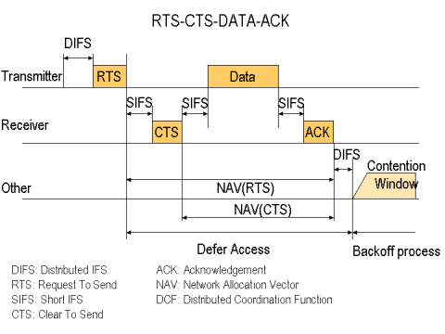
RTS-CTS-DATA-ACK
not examinable
DIFS: Distributed IFS (Inter-frame Space)
for carrier sense
RTS: Request-To-Send SIFS: Short IFS
CTS: Clear-To-Send ACK: Acknowledgement
NAV: Network Allocation Vector
Notes:
Now this is a graphical illustration. the transmitter sends RTS and after a short time period, the receiver will transmit a CTS. Now, this CTS will go back to the transmitter and also go to other stations. Now, this CTS will include a field saying, "I allow who to transmit." Now this transmitter can transmit and other stations will try to defer their pending transmissions. After the transmission, the receiver will transmit an ACK and then after a short time period, we will open another contention window for the RTS, because the RTS need to compete for the receiver's CTS, so that's why we say it is a contention window.

Slide 30
Handshaking in Hidden Terminal Problem
not examinable
A
B
AP
RTS(B)
RTS(A)
reservation collision
RTS(A)
CTS(A)
CTS(A)
DATA (A)
time
ACK(A)
ACK(A)
Notes:
Now we will illustrate how this RTS and CTS address the hidden terminal problem. We have two stations; A and B, and both of them want to transmit data to the AP. you can understand AP as another station, and this axis is time. Now, if the two stations transmit the RTS signal at the same time, in the RTS they will need to identify themselves, so this is the ID of the station, and initially the two RTS collide at the AP, then the AP cannot decode the RTS signal, then of course the AP will do nothing. After a certain time period, some time-out, this station A will try to re-transmit the RTS and for this time, the B does not transmit the RTS, so there is no collision, then this AP will transmit the CTS and indicate that "I clear A for transmission." Now A can transmit. I forgot to mention, at this time instant after B receives this CTS(A), then B will know that, "I'm not cleared for transmission. This CTS is for some other hidden terminal." Then the A can transmit and the AP will send the ACK.

Slide 31
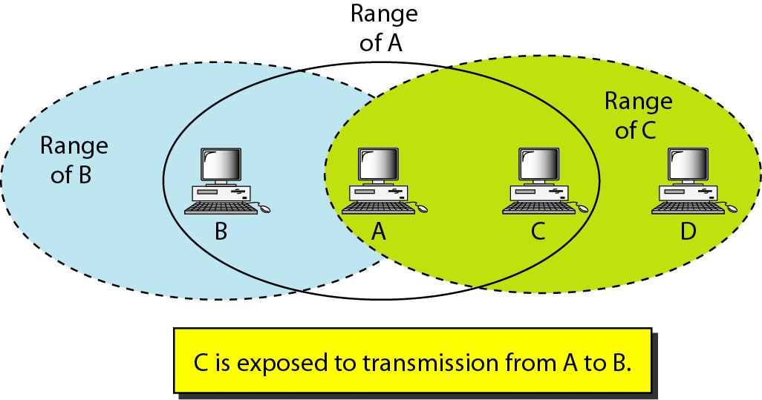
Exposed Terminal Problem
not examinable
Notes:
Now we will talk about another problem, which is the exposed terminal problem, In this problem, we consider four stations, and we say C is exposed to the transmission from A to B, meaning that If C has data to be transmitted to D, and at the same time, A is transmitting data to B, so from the CSMA principle, because C is close to A, so C will be able to detect the occupancy of the channel by A, meaning C can detect the ongoing transmission by A. C is also not sure whether this A's transmission will arrive at D. C, basically does not have this information, then the C's decision should be "Delay the transmission. Wait for some time", but in fact, C can transmit. If C transmit, then at the D's position, the A's signal is very weak, meaning that in fact, those two transmissions can happen at the same time without a problem, because after the signal attenuation, A's signal is very weak at D, then this weak version of A's signal will not interfere much with C's signal. So actually, those two transmissions can happen at the same time, but from the CSMA principle; C should delay the transmission. In summary, from this example, we see that the signal decay also causes wasting of the transmission opportunity, and this is caused by the exposed terminal problem

Slide 32
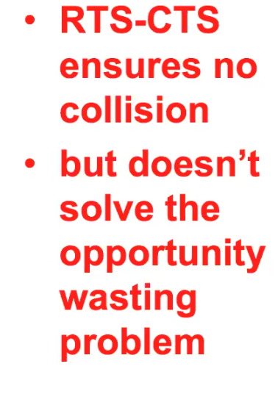
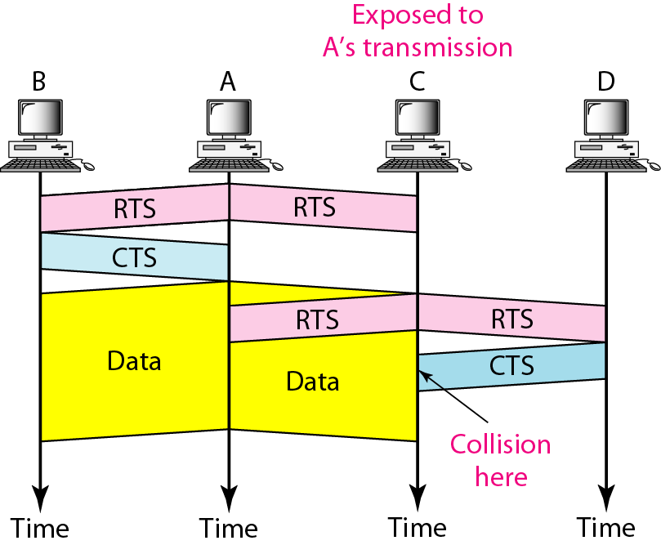
Handshaking in Exposed Terminal Problem
not examinable
Go to www.menti.com and use code 23608549
Engagement and critical thinking!
Notes:
Now we will see how the CTS and RTS mechanism will perform in this exposed terminal problem. We know that the CTS-RTS can ensure there is no collision of actual data, because you have to clear the channel first before you transmit. It can ensure no collision, but the result for this problem is; the RTS and CTS does not solve the opportunity wasting, so we will illustrate. Now, this C is exposed to A's transmission, so A want to transmit data to B and C want to transmit data to D, so A, before the transmission, it will send the RTS, and the intended receiver is B, so B will transmit the CTS, and this CTS cannot arrive at C, it can only heard by A. Now, A can transmit the data and this data will arrive at both B and C, because C is exposed to A's transmission. Now, C has data to be transmitted to D, so C will transmit the RTS and this RTS can be received by both the A and D, and at this point this RTS actually cause no problem to this ongoing transmission, because this RTS cannot arrive at the destination of B, and this RTS can be received by D, and D will reply with the CTS, but the trouble is; at this time instant, this C is exposed to this ongoing data transmission from A, so in fact for C, we will have a collision, so C cannot receive this CTS, so from the RTS and CTS protocol, C cannot transmit, so this shows that the RTS and CTS mechanism does not address the opportunity wasting problem. This RTS and CTS can clear any possible collisions, and we consider it as a good design to compromise a little bit of the transmission opportunity, but we make sure this wireless network does not have collisions. Okay, so this is the design rationale of the RTS and CTS. Overall, the RTS and CTS is not a perfect technology to address all problems, but at least it's a decent technology. We will continue to teach this Wi-Fi network next week, now we still have a few minutes and as usual, we will look at some questions and you can vote your question.

Slide 33
802.11 Frame
not examinable
2
2
6
6
6
2
6
0 - 2312
4
frame
control
duration
address
1
address
2
address
3
seq
control
address
4
payload
CRC
Address 4: used only in ad hoc mode
Address 1: MAC address
of wireless host or AP
to receive this frame
Address 3: MAC address
of router interface to which AP is attached
Address 2: MAC address
of wireless host or AP
transmitting this frame
Notes:
Now we will continue with the frame structure of the wifi network. And we use this picture to show this frame structure. in the frame header we have some addresses. The first address is the MAC address for the AP that should receive this frame. And the second address is the MAC address of the transmitter of this current frame. And the third address is the MAC address of the router that the wireless AP is attached to. We also have another address but this address is used in ad hoc mode, and we know that in today's wifi network we often use the infrastructure mode, so we typically do not use this ad hoc mode.

Slide 34
802.11 Addressing
not examinable
Internet
H1
R1
router
AP
R1 MAC addr H1 MAC addr
dest. address
source address
Ethernet frame
AP MAC addr H1 MAC addr R1 MAC addr
address 1
address 2
address 3
802.11 frame
Notes:
Right, so this an illustration of how the wifi MAC address or the wifi header is transformed to the ethernet header. So now we have this wifi network and this is the AP and this is the router and this AP is connected to the router. Then this is the header of the wifi frame and this first address is the Mac address of this AP, meaning that this AP should receive this frame. And then the next one is the MAC address of this computer host, each one. Then the third address is the MAC address of this router. So, this router basically has two ports. This port is connected to this AP and this router is also connected to the internet, so this router will have two MAC addresses for those two ports. And this AP will only have one MAC address. Then after this AP received this wifi frame it will convert to an ethernet frame, and this frame structure is the same as what we mentioned when we went through the ethernet. So the first address is the destination address of this ethernet frame which is this router. And the next address is the computer host MAC address, which is this H1's address. So now you can see that after the AP further forwarded the packet through to this router, the AP's MAC address is removed. So actually, from the perspective of this router, the existence of this wifi AP is not that important, meaning that, at the router, what the router sees is just a normal ethernet frame, such as this H1 is transmitting the frame directly to the router.

Slide 35
802.11 Advanced Capabilities
not examinable
Synchronization - finding and staying with a WLAN - synchronization functions
Power Management - sleeping without missing any messages - power management functions
Roaming - functions for joining a network - changing access points - scanning for access points
Management information base
Notes:
the wifi network also has some advanced capabilities, like the synchronization among the computer stations in the wifi network, and also the power management because we know wireless communication consumes lots of power. So you should enable sleeping without missing any messages. And also the roaming means that when the mobile terminal is moving from one area to another area served by two different APs, then you should support this handover. So we want to go into the details of those issues because they are advanced topics.

Slide 36
Multi-Access Reservation Protocol (MARP)
Examinable
Notes:
Now we will look at the last part of the wireless network which is this Multi-Access Reservation Protocol. So remember, the wifi adopts the RTS and the CTS to avoid the collision, and the purpose of this RTS and CTS is actually to allow the wireless terminals to reserve the channel. Then we can avoid the collisions.

Slide 37
Multi-Access Reservation Protocol
Two-Phase Protocol
Phase 1: Channel Reservation
Phase 2: Data Transmission
Examinable
Phase 1: Reservation
N
Phase 2: Transmission
Trial
u units of time
Y
Transit data frame
v units of time
Notes:
Now we will analyze the performance of this channel reservation. This channel reservation and the data transmission can be abstracted in this way. We have two phases. In the first phase, the wireless station will reserve the channel and once the channel is successfully reserved, meaning that the wireless terminal receives the CTS signal from the AP, the wireless terminal can move on to the data transmission phase, which is phase two. Now we will quantify the performance of this two-phase process. First of all, we will assume that we have some data to be transmitted, and the transmission time of those data will take u units of time. And then, in the first phase, we assume that each reservation trial will take v units of time. because we know the reservation may not be successful at the beginning, you may need to try a few times to reserve successfully the channel. Remember that the RTS signal can also collide, then once you collide, you need to redo the reservation again. So, in this illustration, we use those multiple slots to represent the repeated reservation process. So once the reservation is successful, then the wireless station can move on to the second phase of data transmission.

Slide 38
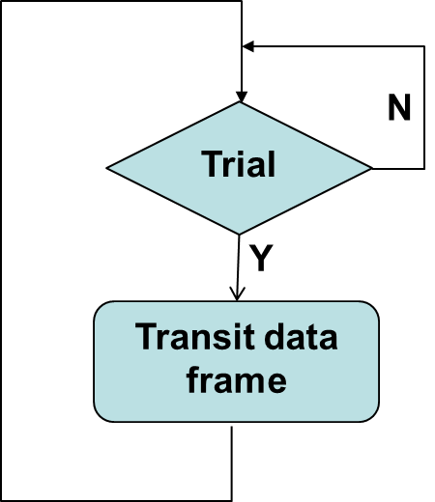
MARP Transmission Window
Phase 1: Reservation
Examinable
Phase 2: Transmission
u units of time
How many reservation trial frames?
Assume that the channel utilization in reservation phase: S_{r}
Number of reservation trial frames to reserve the channel: X
X = 1 (the first trial succeeds) with probability of S_{r}
X = k (the first k-1 trials fail, the k^{th} trial succeeds) with probability of S_{r}(1-S_{r})^{k-1}
This is a geometric distribution, so E[X] = 1/S_{r}
The average transmission window is u + v/S_{r} units of time
Notes:
Now, we first analyze how long the reservation phase will take. We assume, in each time slot, the successful probability of the reservation is SR. Now we use x to denote the number of reservation trials that this wireless station performs. And if x is one, meaning that this wireless station reserves the channel successfully in the first time-slot, and then this event happens with the probability of SR, because we defined SR to be the reservation successful probability. Now if x is k, it means that the previous k-1 trials fail, the reservation is not successful, but the last reservation is successful, then what is the probability of this event? It will be given by this expression, SR represents the successful probability for the last event and the 1-SR is the probability that any one of the k-1 trials fails. And then, since we have k-1 event failures, the expression is (1-SR) up to k-1. Then we multiply those two together, then this is the overall probability for this event of x is k. So the x is a random variable and follows the geometric distribution and then you can know that the expected value of x will be 1/SR. So, this expected value is intuitive, meaning that in each time slot you have a successful probability of SR, then the number of trials that you need to perform will be 1/SR. So, for example, if SR is 0.5, it means that in each time slot, you have an equal probability for success and failure. On average, you will need to take two time slots, you need to do two times of reservation to be successful. Now, we know that the average number of time slots in this first phase will be 1/SR and the length of each time slot is v, so the length of the first phase will be v/SR. And then, after the successful reservation, we move onto the second phase and the duration of the second phase is u. So, the total length of this process is u+v/SR.

Slide 39
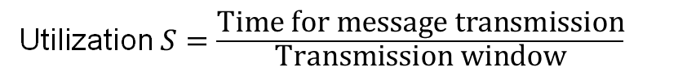
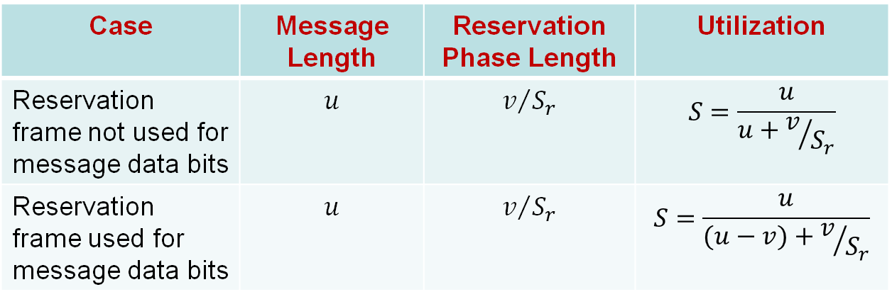
MARP Utilization
Examinable
Utilization $S=\frac{\text{Time} \text{for} \text{message} \text{transmission}}{\text{Transmission} \text{window}}$
Case | Message Length | Reservation Phase Length | Utilization
Reservation frame not used for message data bits | $$u$$ | $$v/{S_{r}}$$ | $$S=\frac{u}{u+v/{S_{r}}}$$
Reservation frame used for message data bits | $$u$$ | $$v/{S_{r}}$$ | $$S=\frac{u}{(u−v)+v/{S_{r}}}$$
Notes:
Now, we have different versions for this MARP and we will derive the Utilization of this protocol. So, first of all, this is the case that we just analyzed. We do the reservation, on average, for v/SR units of time. Now we use u units of time for the data transmission. So, the Utilization of this whole process will be u/total length of this whole process, which is u+v/SR. Meaning that during this time duration, only u units of time are utilized for data transmission. So we can also say this is the utilization of the data link. Now, in the second case, we also use the reservation frame to transmit some data, to transmit v units of data, because each time slot is v units of time. we will use this last time slot during the reservation phase to transmit some data. And the total data to be transmitted is u, so now in the second phase, the volume of data to be transmitted will be u-v. And now we calculate the Utilization again. So, the u is the amount of data that we will transmit. Then, what is the total length of this process? We know that the duration of this first phase is v/SR. And the duration of the second phase is u-v. So, the total length is (u-v) + v/SR, which is this denominator. So this is the utilization for the second case. Now we look at the last case. So, we will assume we change the definitions of the symbols a little bit. So in this case, we will assume that we will have u+v units of data to be transmitted. And we also use the last frame, the successful reservation frame to transmit some data. Then the length of the second phase will be u units of time and the length of the first phase is v/SR. So, then, for this last case, the Utilization is u+v, which is the data to be transmitted, divided by u+v/SR, which is the total length of this process. So, here you have three cases and the only difference is whether you use the last reservation frame to transmit data, and the calculation of u and v are slightly different.

Slide 40

MARP Example
Examinable
Consider an experimental LAN using an MARP for data transmission. The protocol consists of two phases. In phase 1, it adopts some MAC protocol for transmission stations to reserve the channel. In phase 2, when one station reserves the channel, it transmits one frame. The length of reservation frame is 5ms, and the length of the data frame is 1s. No information bit is carried in the reservation frame. If the MAC protocol used in phase 1 has a utilization of 0.5, what is the Utilization of the multi-access reservation protocol?
CRACK Framework:
Context: MARP with no data bits in reservation
fRamwork: the Utilization of MARP is S = u/(u+v/S_{r})
Apply: u = 1s, v = 5ms = 0.005s, S_{r} = 0.5
Calculation: S = 1/(1+0.005/0.5) = 1/1.01 ≈ 0.99
checK: S<=1
Notes:
Now we look at this example. So, in this example, in phase one we use a MAC protocol for the channel reservation. And the length of the reservation frame is just 5ms. And the length of the data frame is 1s. And no information bit is carried in the reservation frame, meaning that we consider the first case. And if the reservation successful probability is 0.5, now what is the Utilization of this protocol? we will use this Utilization formula. And u is the data length, which is 1s. So, the v in this case is 5ms, the SR probability is 0.5. Then, you plug those numbers into this formula, then you can calculate the utilization or the Utilization to be 99%. Last one is to check your result because the utilization should be less than one, so then this is an okay result.

Slide 41
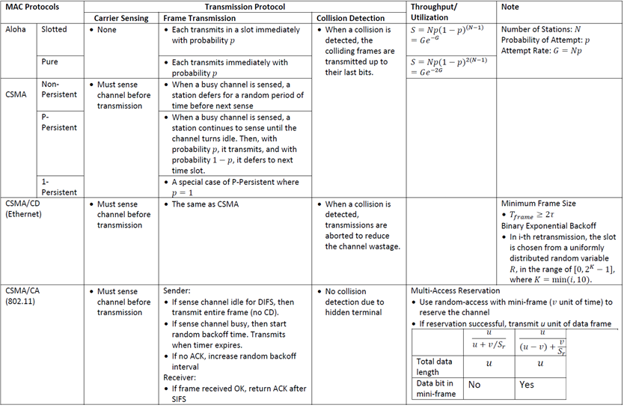
Local Area Network Summary and Q&A
Notes:
Right, so this is a summary of what we learned so far and I will not go into the details here. This is used for you to review what you have learned.

Slide 42
Learning Objectives
WLAN Overview
Understand two alternative WLAN architectures
802.11 Physical Layer
Understand different transmission schemes
802.11 MAC Layer
Understand hidden and exposed terminal problems
Understand CSMA/CA protocol
Multi-Access Reservation Protocol (MARP)
Understand the scheme of MARP
Calculate and maximize Utilization for MARP
Notes:
Now we summarize the learning objective. We have overviewed WLAN. We have talked about the physical layer and the MAC layer of 802.11 protocol. It is important for you to understand hidden and exposed terminal problems, and also understand CSMA/CA protocol. Finally, you should also be able to understand MARP and perform computations. MARP also appears in Tutorial 3.

Slide 43
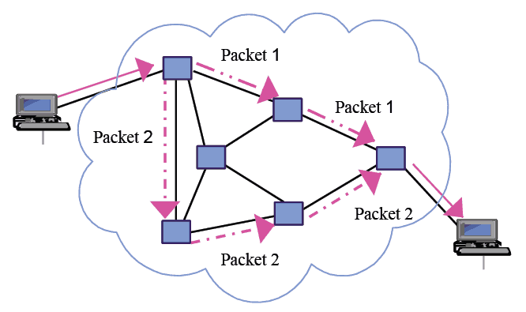
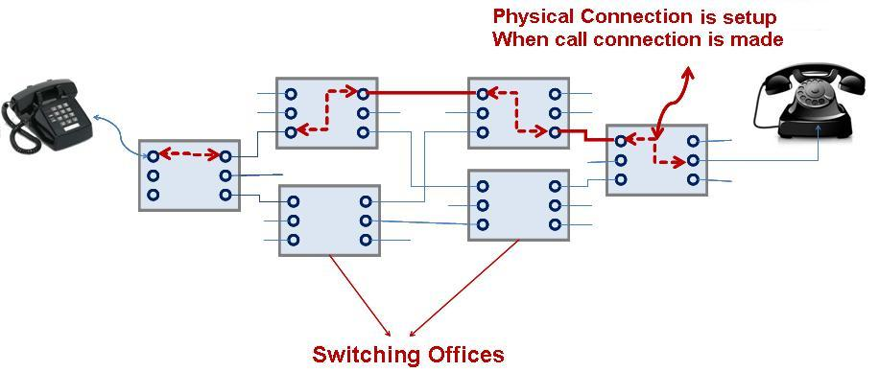
Topic for the next lecture
Two network paradigms:
Circuit Switching
(e.g., Telephone Network)
Packet Switching
(e.g., the Internet)

Slide 44


After-class question
Which one do you prefer?
Restaurant A:
Restaurant B:
Requires reservations.
Neither requires reservations
nor accepts reservations.
Notes:
Consider two restaurants--one that requires reservations and another that neither requires reservations nor accepts them. Which one do you prefer?

Slide 45
Reading Material
not examinable
Notes:
At the end, we have some additional materials. I will not talk about them because they are not examinable for Quiz 1.

Slide 46
Wireless Physical Layer (I)
not examinable
Physical layer conforms to OSI (five options)
1997: 802.11 infrared, FHSS, DHSS
1999: 802.11a OFDM and 802.11b HR-DSSS
2001: 802.11g OFDM
802.11 Infrared
Two capacities 1 Mbps or 2 Mbps.
Range is 10 to 20 meters and cannot penetrate walls.
Does not work outdoors.
802.11 FHSS (Frequency Hopping Spread Spectrum)
The main issue is multipath fading.
79 non-overlapping channels, each 1 Mhz wide at low end of 2.4 GHz ISM band.
Same pseudo-random number generator used by all stations.
Dwell time: min. time on channel before hopping (400msec).

Slide 47
Wireless Physical Layer (II)
not examinable
802.11 DSSS (Direct Sequence Spread Spectrum)
Spreads signal over entire spectrum using pseudo-random sequence (similar to CDMA see Tanenbaum sec. 2.6.2).
Each bit transmitted using an 11 chips Barker sequence, PSK at 1Mbaud.
1 or 2 Mbps.
802.11a OFDM (Orthogonal Frequency Divisional Multiplexing)
Compatible with European HiperLan2.
54Mbps in wider 5.5 GHz band 🡺 transmission range is limited.
Uses 52 FDM channels (48 for data; 4 for synchronization).
Encoding is complex ( PSM up to 18 Mbps and QAM above this capacity).
E.g., at 54Mbps 216 data bits encoded into 288-bit symbols.
More difficulty penetrating walls.

Slide 48
Wireless Physical Layer (III)
not examinable
802.11b HR-DSSS (High Rate Direct Sequence Spread Spectrum)
11a and 11b shows a split in the standards committee.
11b approved and hit the market before 11a.
Up to 11 Mbps in 2.4 GHz band using 11 million chips/sec.
Note in this bandwidth all these protocols have to deal with interference from microwave ovens, cordless phones and garage door openers.
Range is 7 times greater than 11a.
11b and 11a are incompatible!!
802.11g OFDM(Orthogonal Frequency Division Multiplexing)
An attempt to combine the best of both 802.11a and 802.11b.
Supports bandwidths up to 54 Mbps.
Uses 2.4 GHz frequency for greater range.
Is backward compatible with 802.11b.

